Slide 1
Transfer Learning
Powerful usage of Transfer Learning model to solve FoodVision101 classification problem

Slide 2


About me
My name is Mark Chernomorchenko. I study Artificial Intelligence and I solve Machine Learning problems such as regression, classification, object detection using Deep Learning and Neural Networks. In the future I would like to learn how to create Neural Networks for Natural Language Processing, object segmentation problem and so on.

Slide 3
Chapter 1: Convolutional NN
What is a Convolutional Neural Network and how can we use it to solve our problems

Slide 4
Convolutional Neural Network
Layers:
Convolution Layer
Pooling Layer (Min, Average, Max)
Activation layer (ReLU, Softmax)
Flatten Layer
Dense Layer

Slide 5
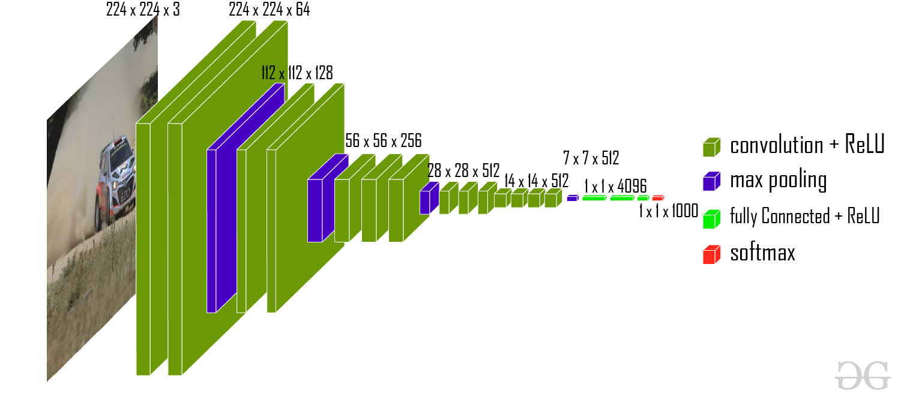

Slide 6
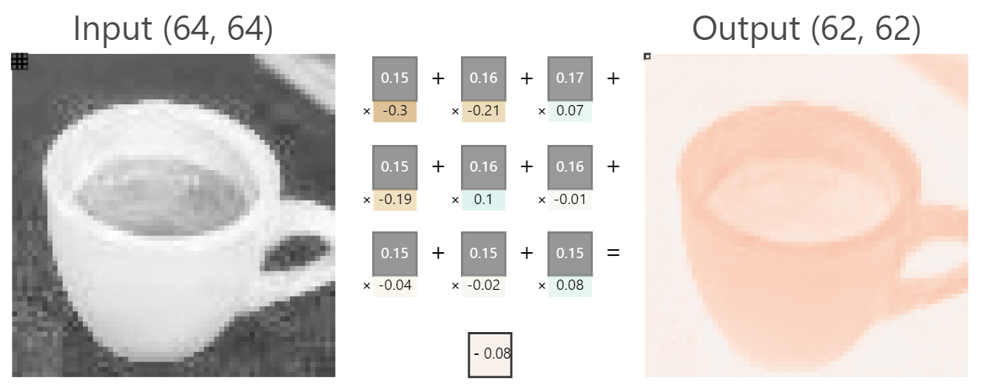
Convolution Layer Example

Slide 7
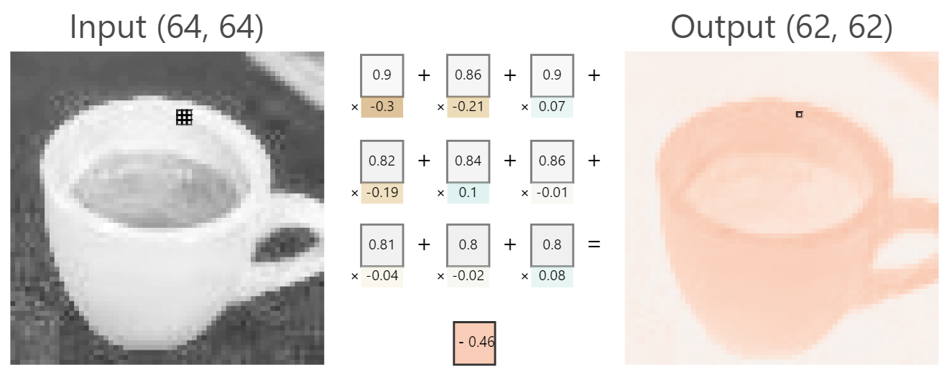

Slide 8
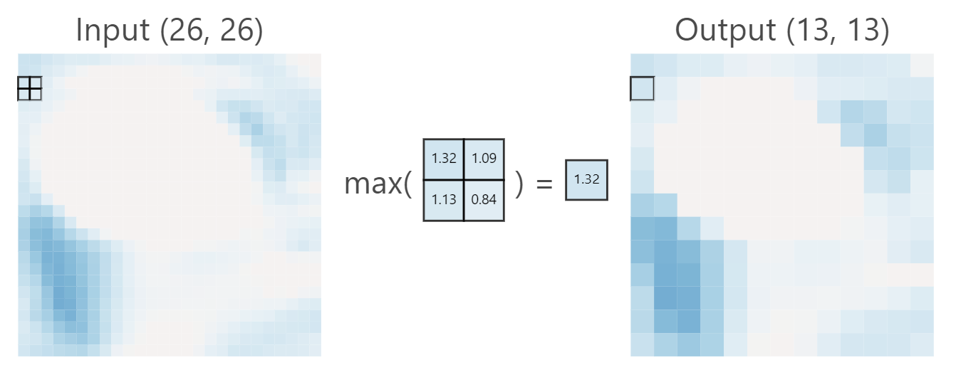
MaxPooling Layer Example

Slide 9
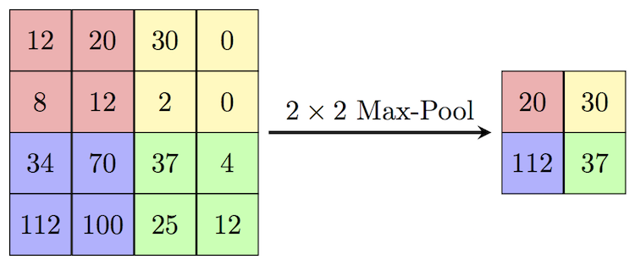

Slide 10
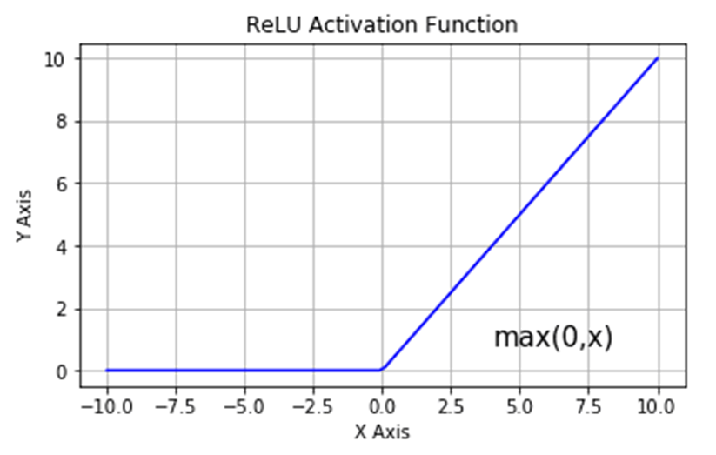
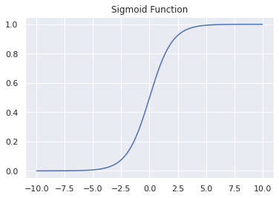

Activation Function Examples

Slide 11
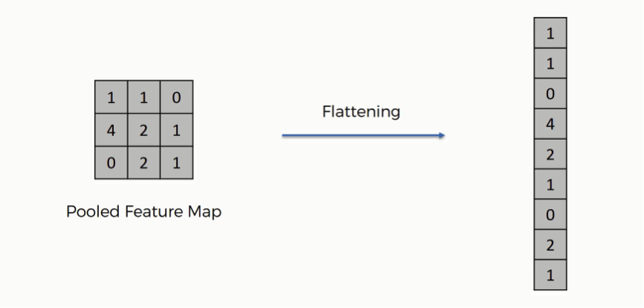
Flatten Layer Example

Slide 12
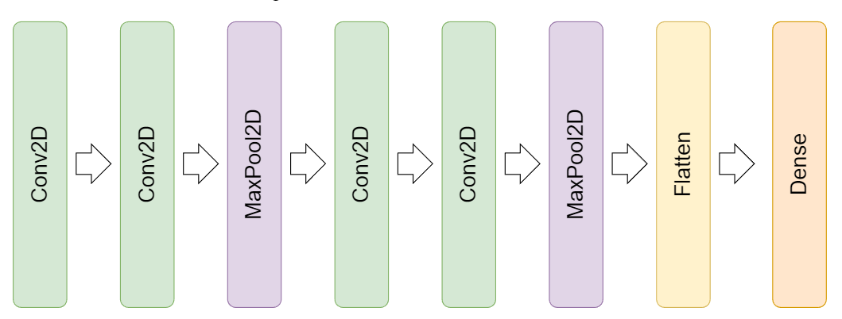

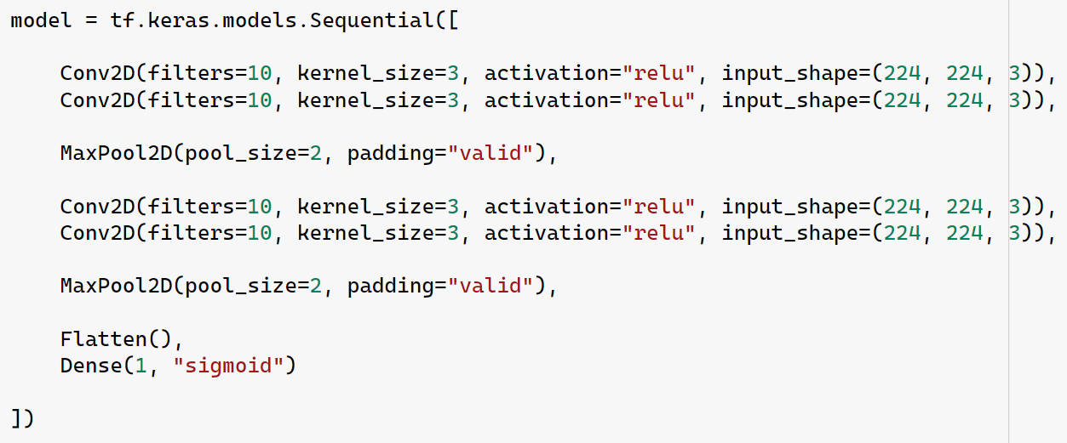
Tiny VGG architecture

Slide 13
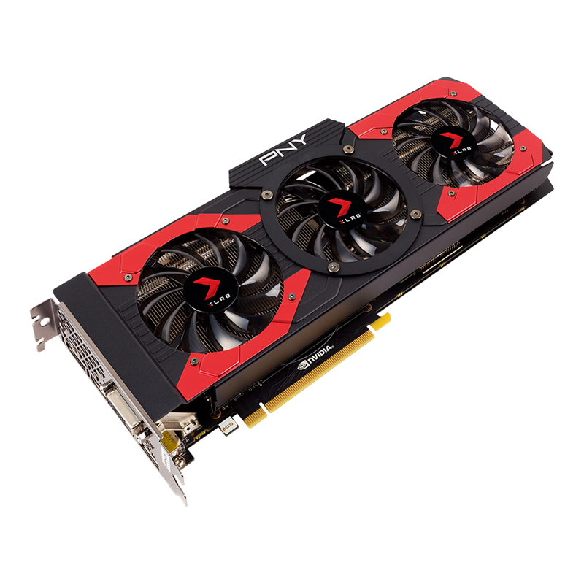
Issues
Time. We need a lot of time to train a CNN model from scratch.
Data. We also need a really huge DataSet!
Сomputing Ability. It is better to have powerful computing possibilities.

Slide 14
Chapter 2: Transfer Learning
In this module I will explain you what is Transfer Learning and how it works

Slide 15
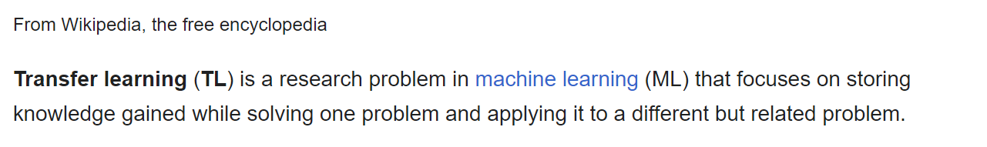
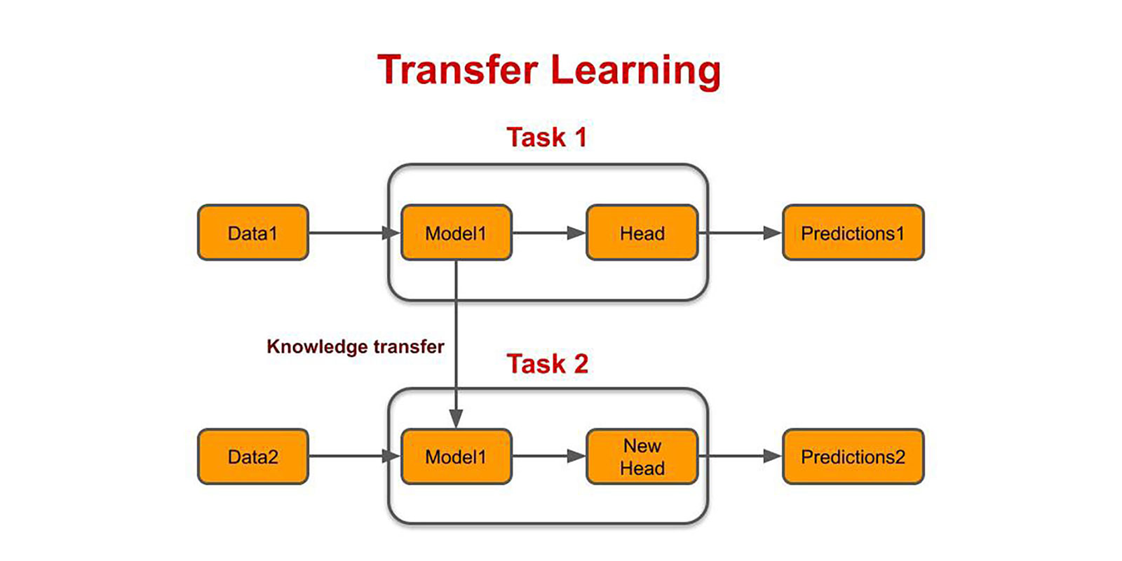

Slide 16
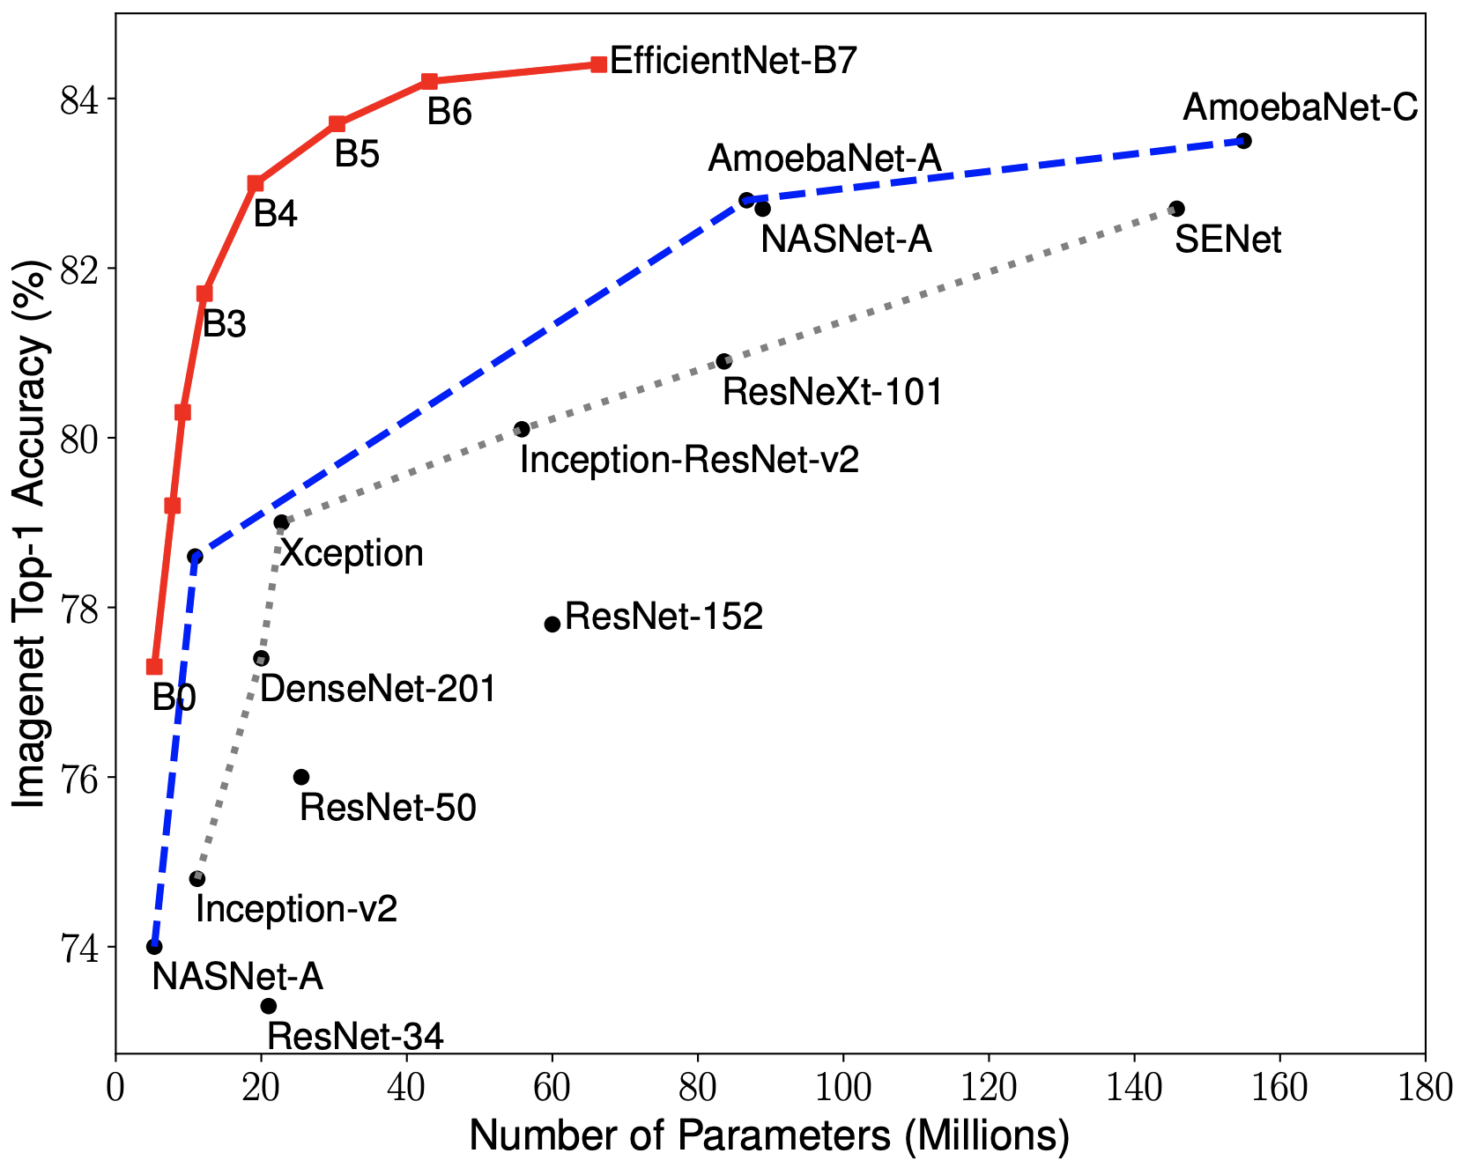

Slide 17

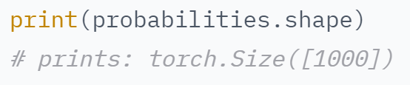
EfficientNet model (EfficientNetB0)

Slide 18
How to create a model using EfficientNetB0?
Step 1: Download our TL model from TensorFlow Hub
Step 2: Freeze our model (prevent our model change its weights while it has been trained)
Step 3: Add other layers to our model if needed
Step 4: Add our transfer learning model to our
Step 5: Add layers after TL model if needed
Step 6: We definitely need a Dense layer with activation function!

Slide 19
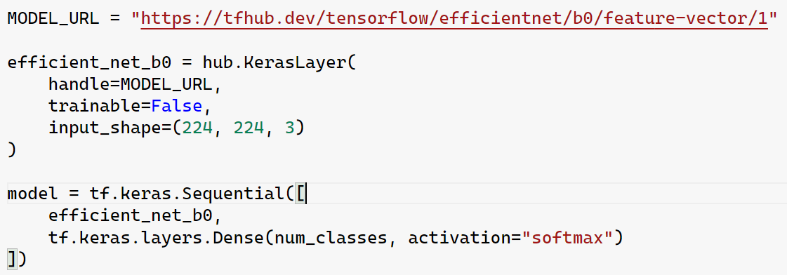
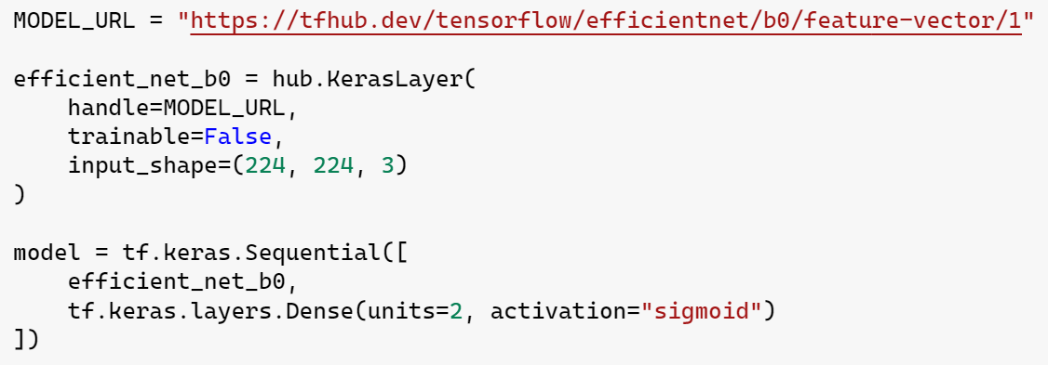

Slide 20
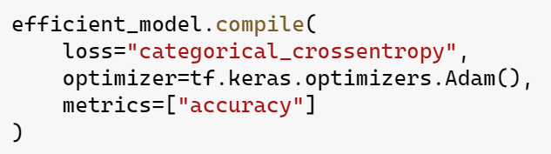
Creating CNN model based on EfficientNetB0: Compilation

Slide 21

Loss Function? Categorical Cross Entropy? Optimizer? Adam? Accuracy?

Slide 22
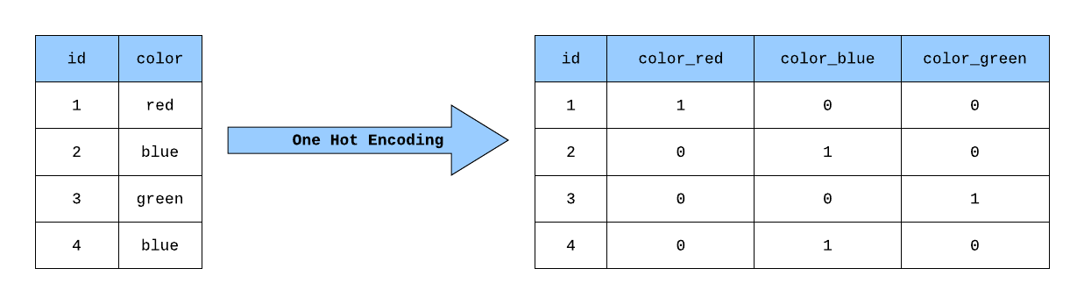
Categorical Cross Entropy. One-Hot encoding:

Slide 23
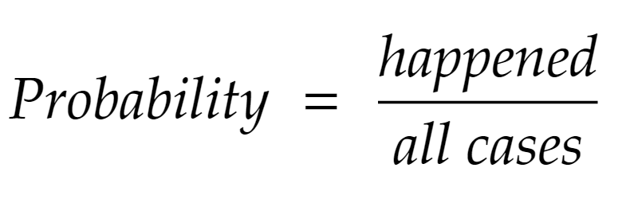
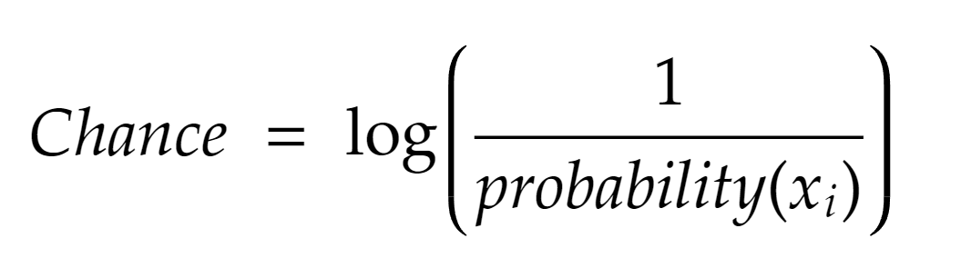
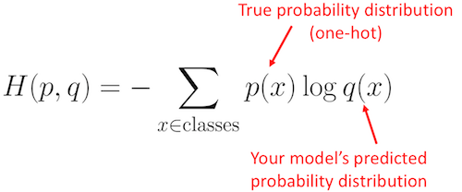
Categorical Cross Entropy

Slide 24




Slide 25
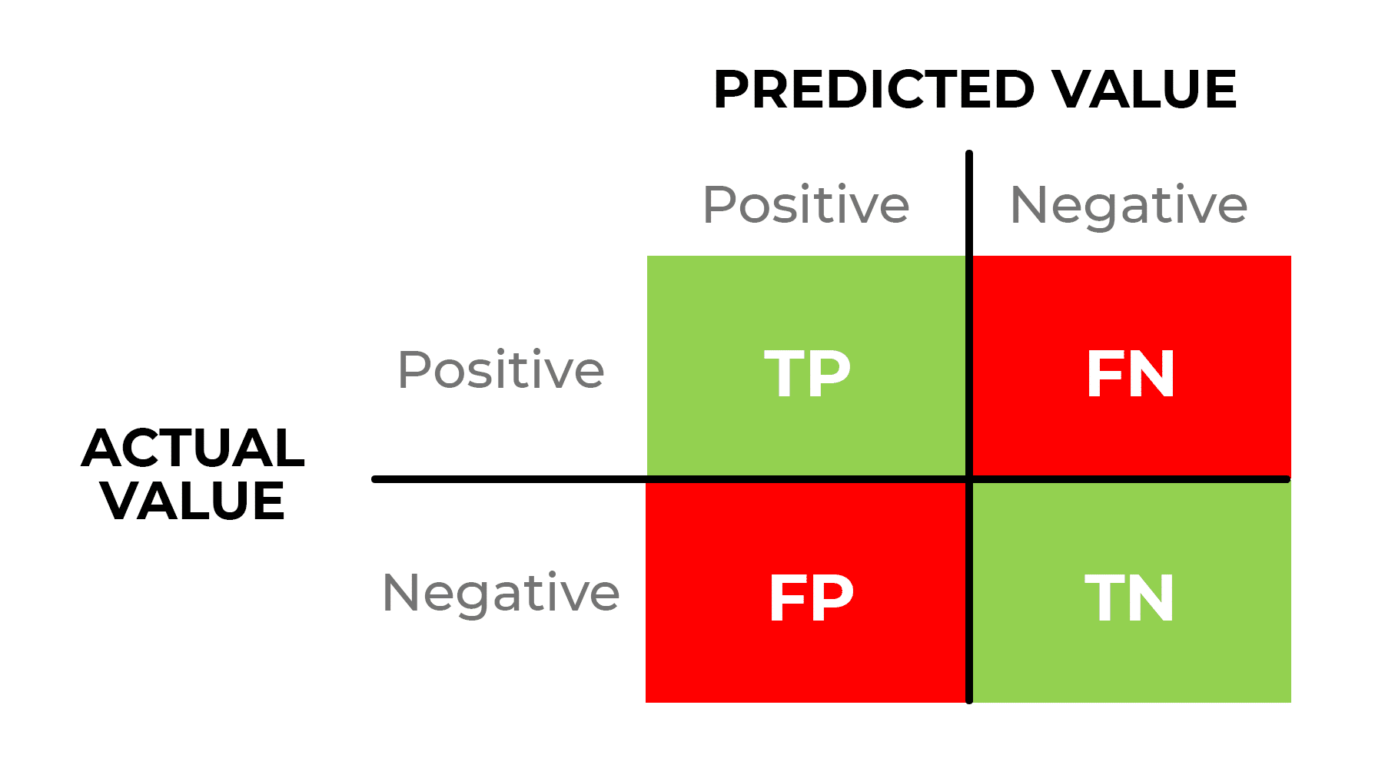
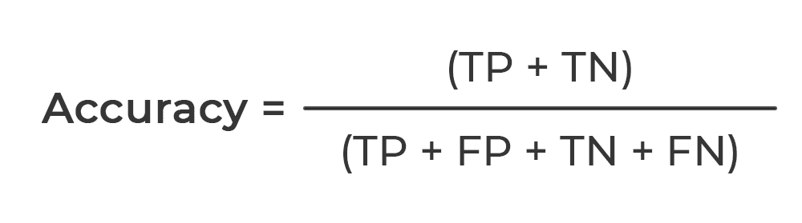
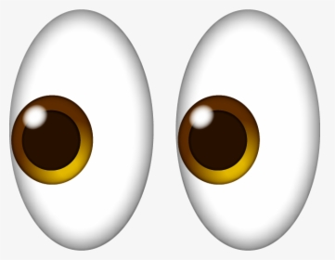
Accuracy

Slide 26
Chapter 3: Train our model
In this module I will explain what strategies I used to train my model

Slide 27
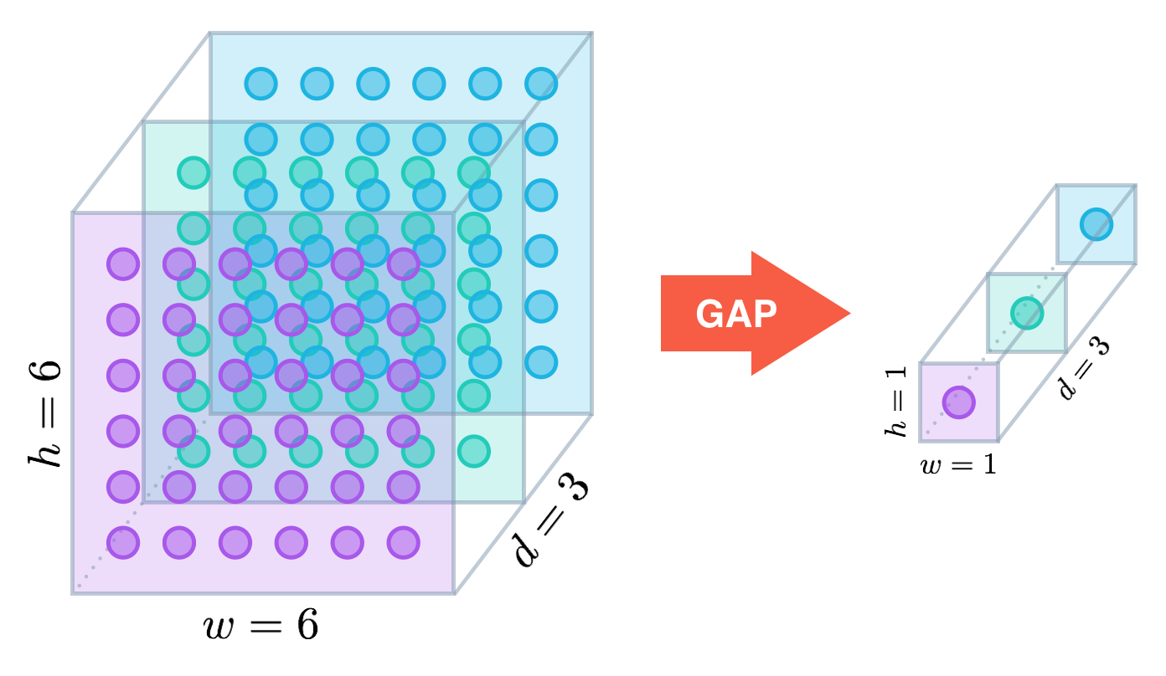
Feature Extraction. GlobalAveragePooling Layer
Input
EfficientNet
Feature Extraction Layer
Output

Slide 28
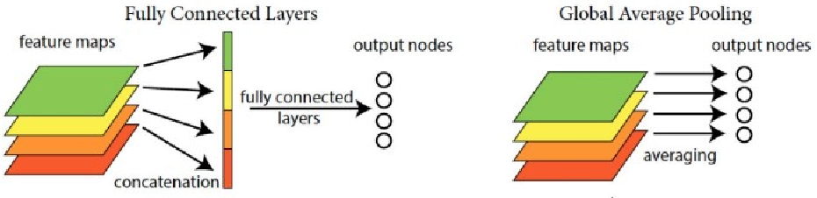
In the last few years, experts have turned to global average pooling (GAP) layers to minimize overfitting by reducing the total number of parameters in the model. Similar to max pooling layers, GAP layers are used to reduce the spatial dimensions of a three-dimensional tensor.

